Slide 1

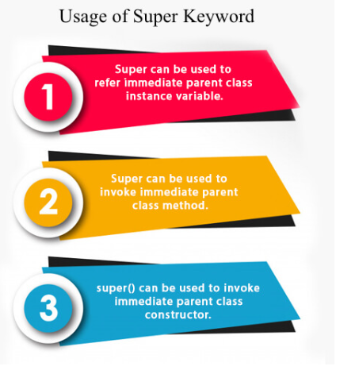

Slide 2
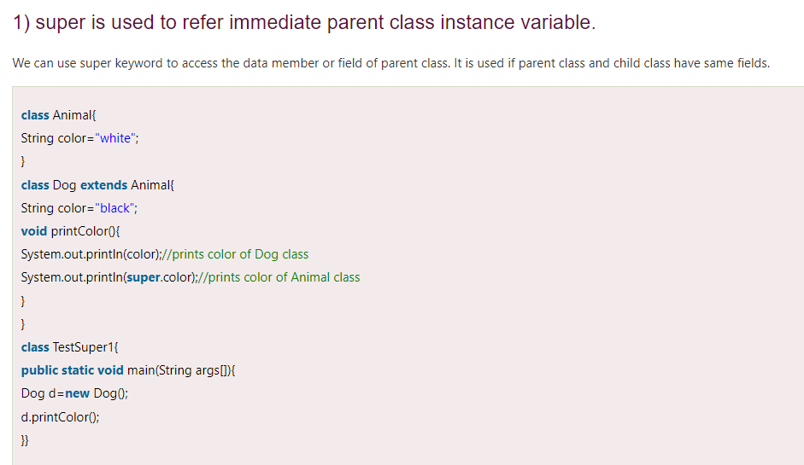

Slide 3
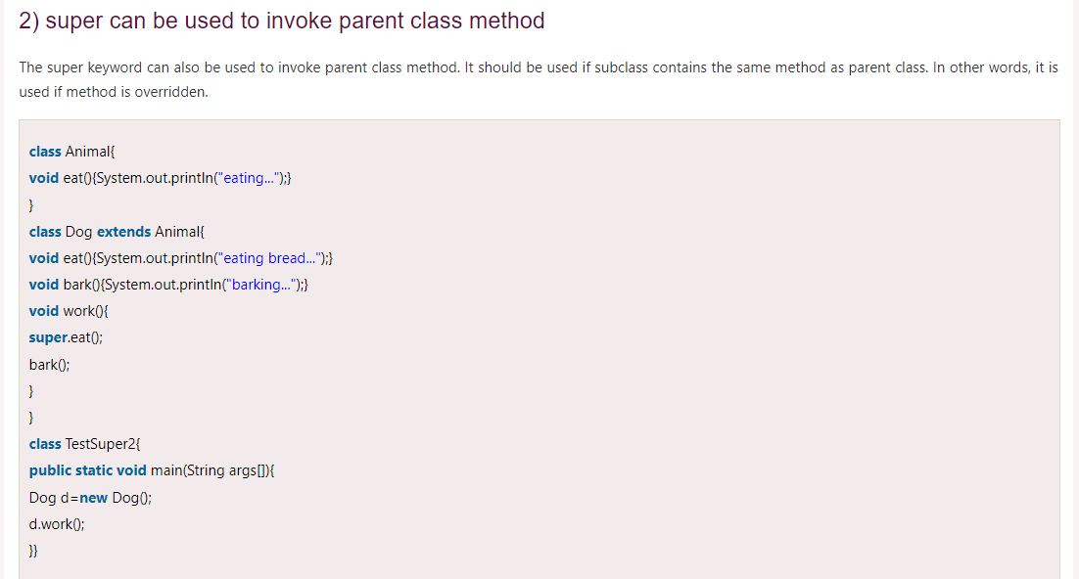

Slide 4
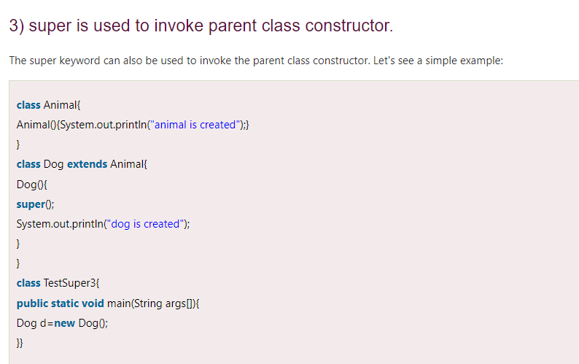

Slide 5
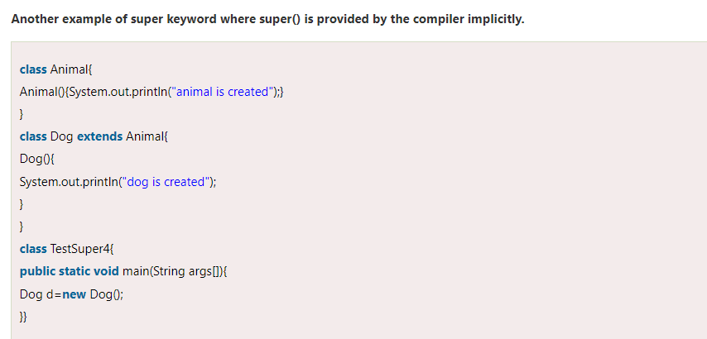

Slide 6
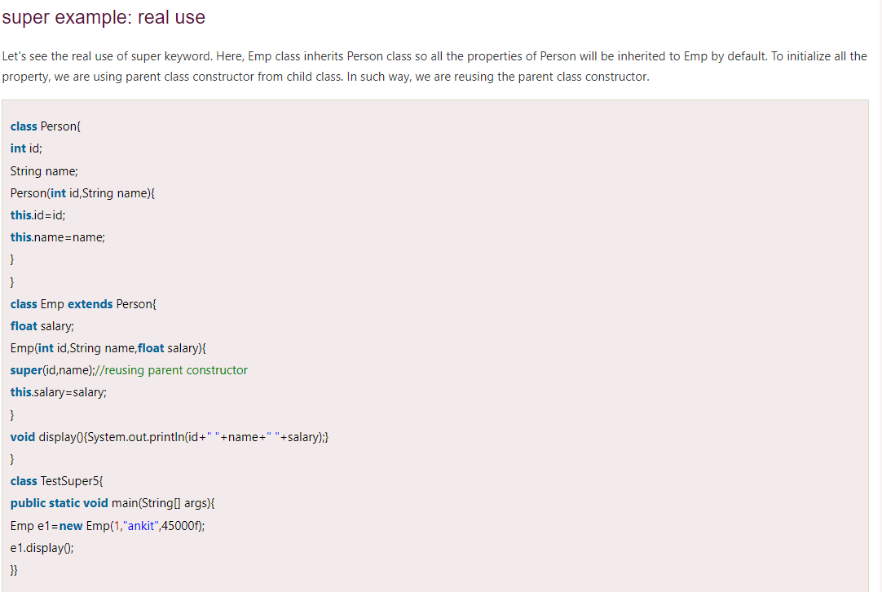

Slide 7
Final Keyword
The final keyword in java is used to restrict the user. The java final keyword can be used in many context. Final can be:
variable
method
class
The final keyword can be applied with the variables, a final variable that have no value it is called blank final variable or uninitialized final variable. It can be initialized in the constructor only. The blank final variable can be static also which will be initialized in the static block only. We will have detailed learning of these. Let's first learn the basics of final keyword.

Slide 8
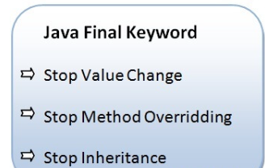

Slide 9
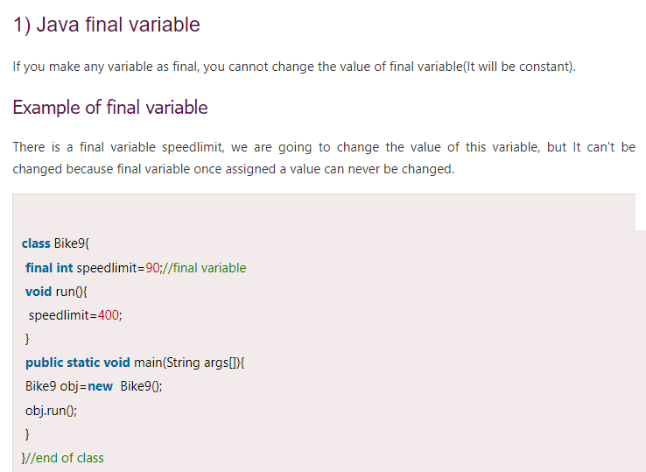

Slide 10
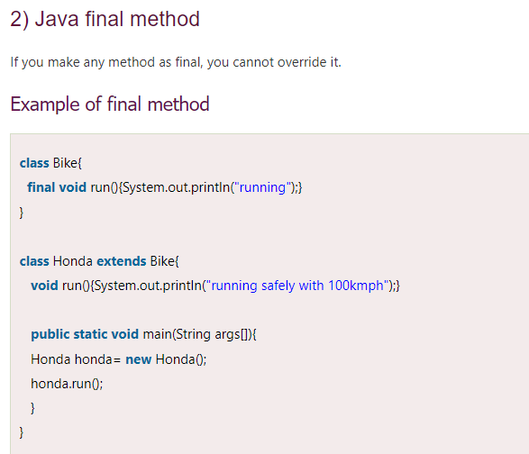

Slide 11
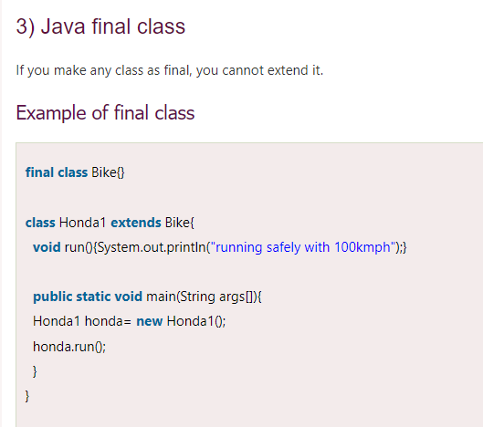

Slide 12
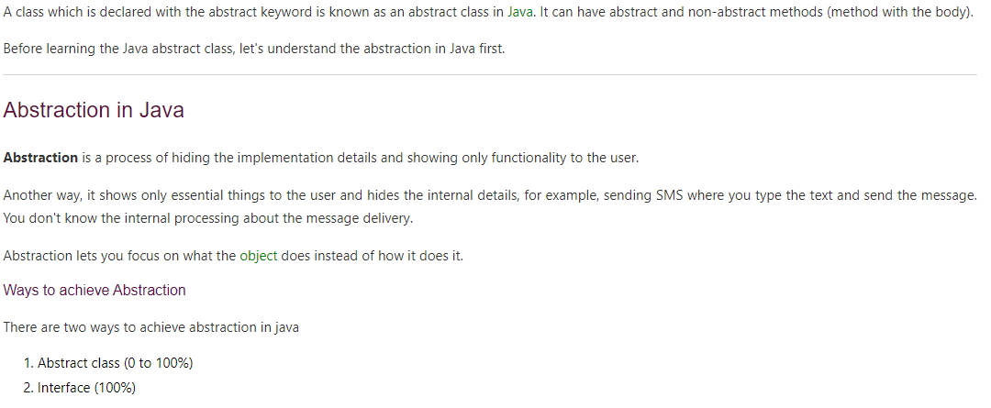
Abstract class

Slide 13

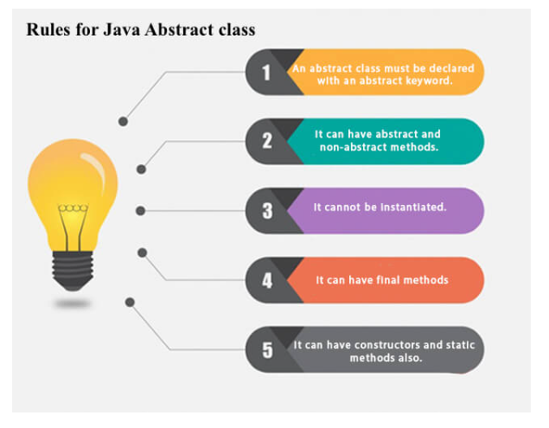

Slide 14
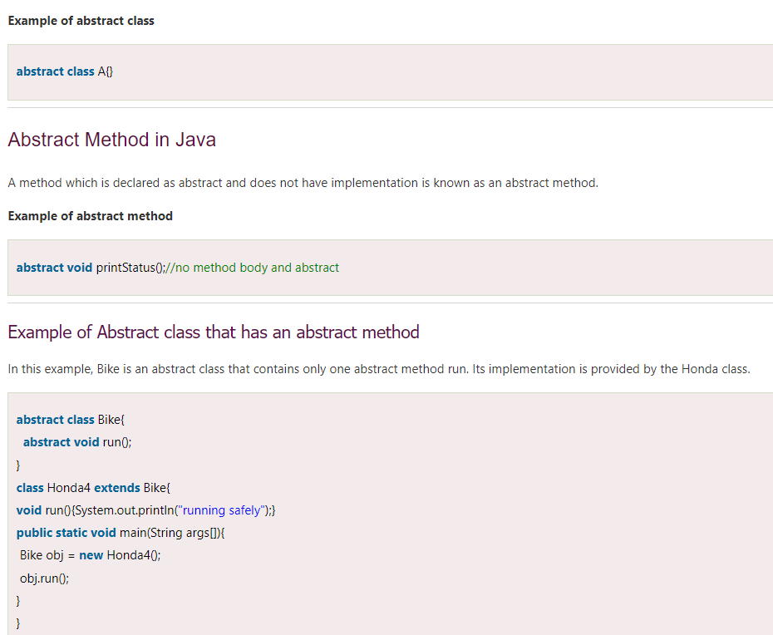

Slide 15
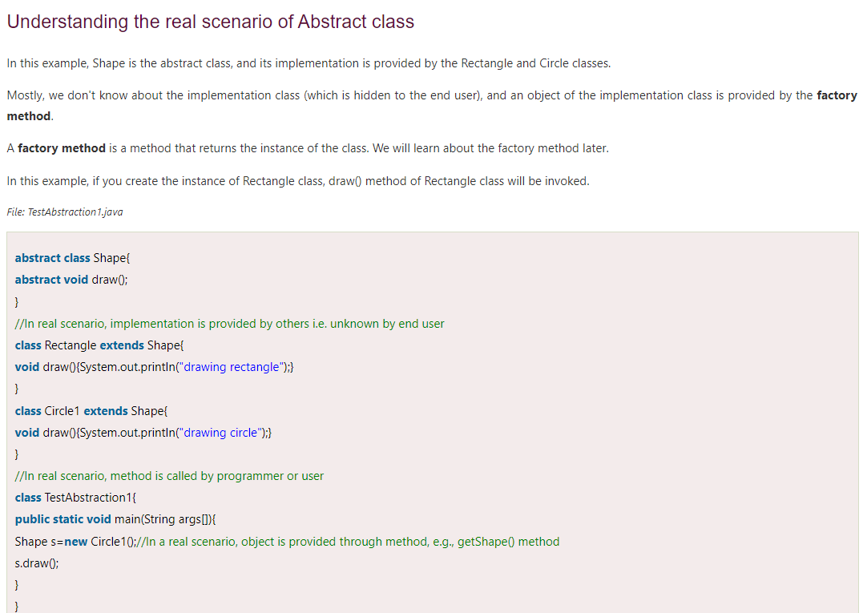

Slide 16
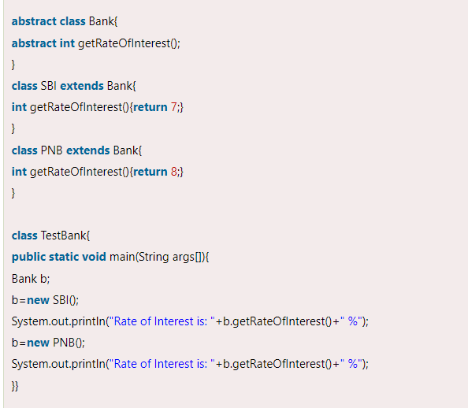

Slide 17
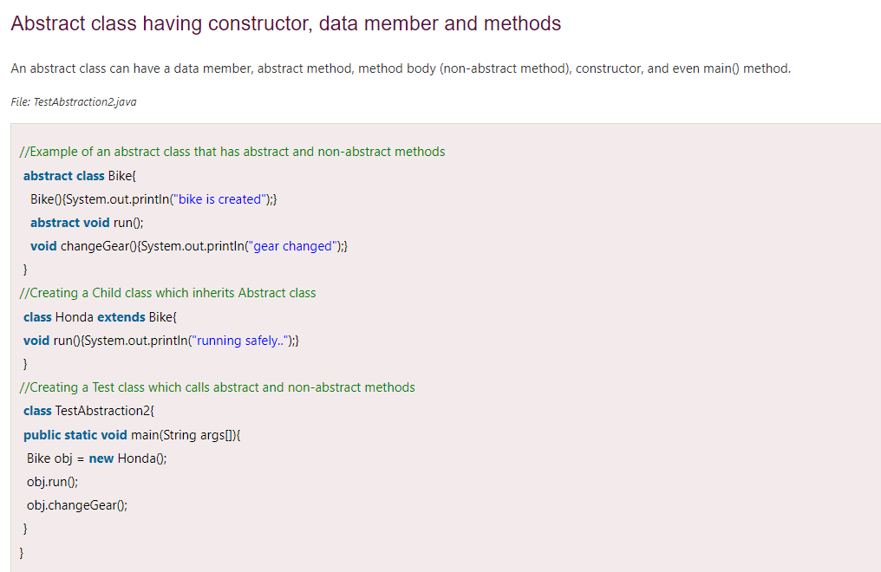

Slide 18
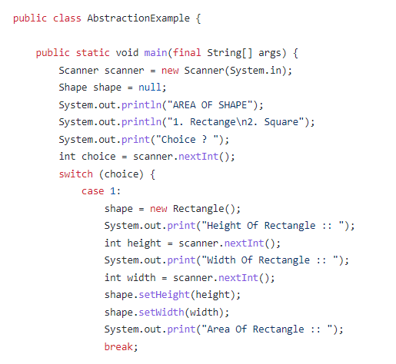
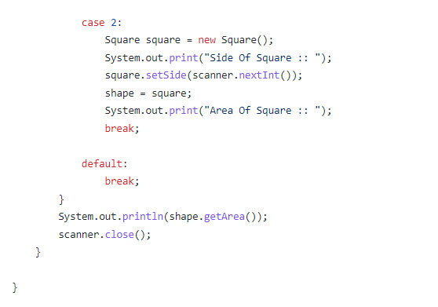

Slide 19
